Slide 1
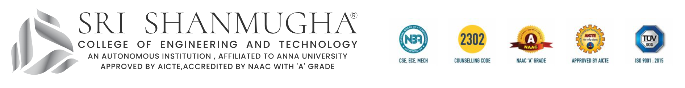
Public Transport Optimisation
Present by :
K.S. Hariprasath (732721106015)
M. Harish (732721106016)
R. Santhosh (732721106031)
K. Kishore sarathi (732721106020)

Slide 2
agenda
Project definition
Design Thinking
I. Empathize
II. Define
III. Ideate
IV. Prototype
Conclusion

Slide 3
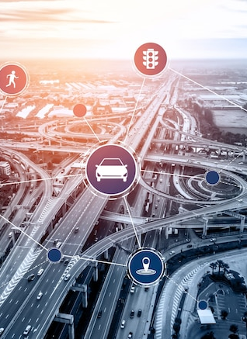
Problem Definition
The public transport optimization project is to enhance the efficiency, accessibility, and sustainability of our urban transportation system while improving the overall passenger experience.
Identify and design the most efficient routes to ensure that public transport services reach high-demand areas, major destinations, and employment centers while minimizing travel time and cost.

Slide 4
Design Thinking
1. Empathize
Daily Commute Challenges: You wake up early, hoping to make it to work or school on time. However, your daily commute is a constant battle against traffic jams, road closures, and crowded streets. The stress and frustration of being stuck in traffic take a toll on your well-being and productivity.
Safety Concerns: Safety is a top priority, and you sometimes feel vulnerable when using public transport, especially during late hours. Improved security measures and better emergency response protocols would give you peace of mind.

Slide 5
2. Define
This optimization aims to provide better transportation services to passengers while minimizing costs, reducing environmental impact, and promoting sustainable urban mobility.
The ultimate goal is to create a transportation system that efficiently serves the needs of the community, reduces congestion, and contributes to the overall well-being of the urban environment.

Slide 6
3. Ideate
Dynamic Routing with AI: Implement an AI-driven system that continuously analyzes traffic data and passenger demand to dynamically adjust bus and train routes in real-time, reducing congestion and travel times.
Smart Transit Stops: Equip transit stops with digital kiosks providing real-time arrival information, maps, and even Wi-Fi, enhancing the passenger experience and reducing wait times.

Slide 7
4. Prototype
2. Contactless Ticketing and Payment System
3. Fleet Management
1. Dynamic Routing and Scheduling
4. IoT Sensor Network for Monitoring
7. Safety and Security
5. Real-time Information Display
6. Eco-friendly Infrastructure

Slide 8
thank you !!!
The inclusion of the IoT sensor network enhances the prototype by providing real-time data for decision-making, predictive maintenance, and improved passenger experiences. This data-driven approach contributes to the optimization of public transport.

